Slide 1

Course code : CSE3009 Course title : No SQL Data Bases Module : 6 Topic : 1
Introduction to Graph DB

Slide 2
Objectives
This session will give the knowledge about
Graph DB Introduction

Slide 3
What Is a Graph?
A graph is composed of two elements: a node and edges.
Each node represents an entity (a person, place, thing, category or other piece of data), and each edge represents how two nodes are associated.
Unlike other database management systems (DBMS), relationships take first priority in graph databases. In the graph world, connected data is equally (or more) important than individual data points

Slide 4
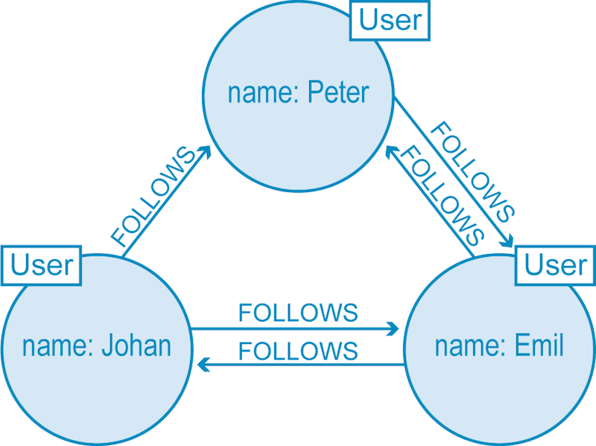
Graph Example
Twitter users represented in a graph database model.

Slide 5
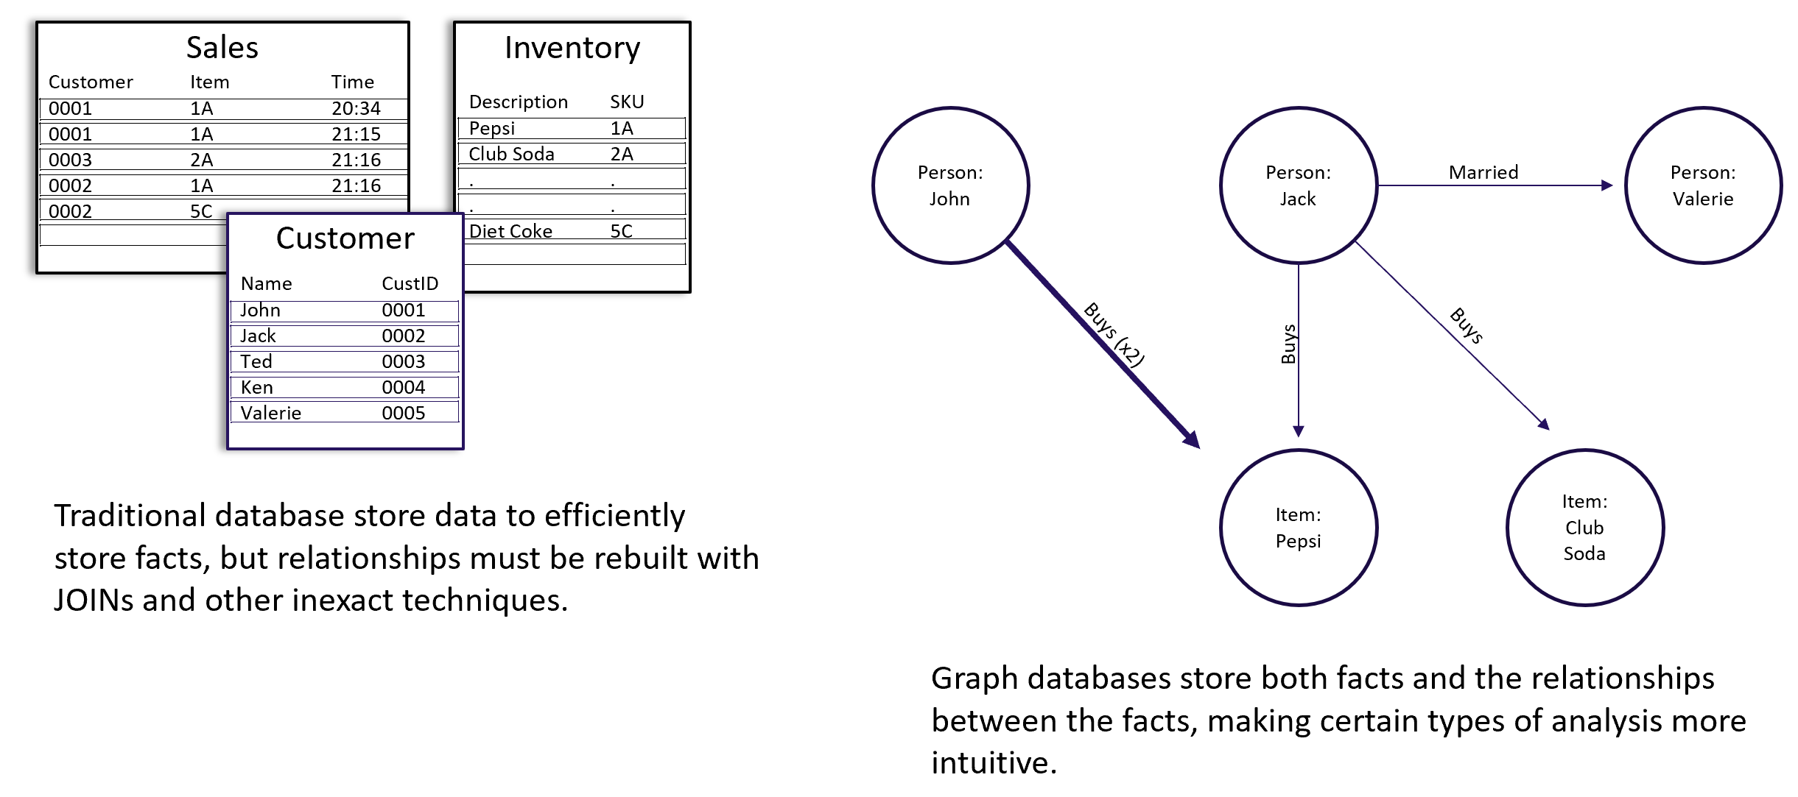
Graph Example
Twitter users represented in a graph database model.

Slide 6
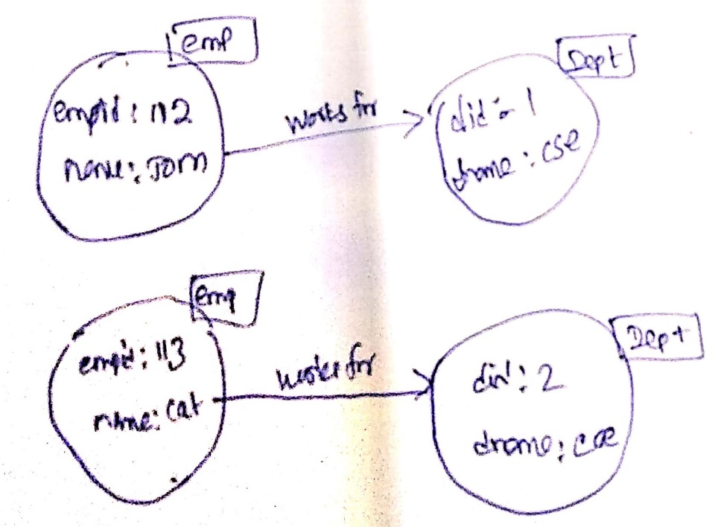
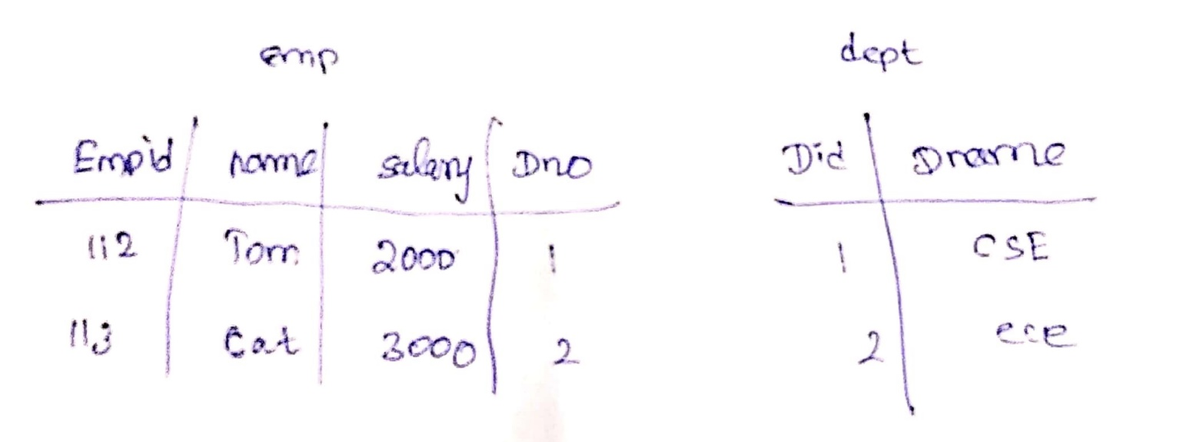
Graph Example

Slide 7
Labelled Property Graph
It contains nodes and relationships.
Nodes contain properties (key-vaule pairs)
Nodes can be labelled with one or more labels
Relationships are names and directed, and always have a start and end node.
Relationships also can contain properties.

Slide 8
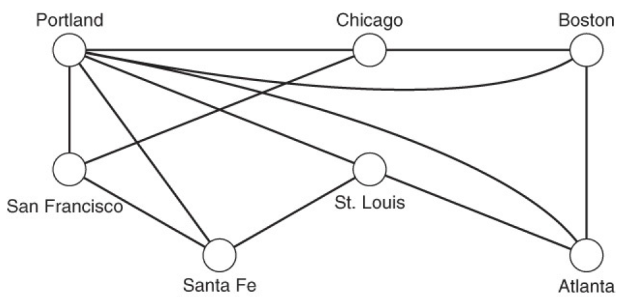
Elements of Graphs
Node
A Node represents an entity marked with a unique identifier - analogous to a row key in a column family database or a primary key in a relational database.
An Edge
An edge, also known as a link or arc, defines relationships between nodes or objects connecting vertices

Slide 9
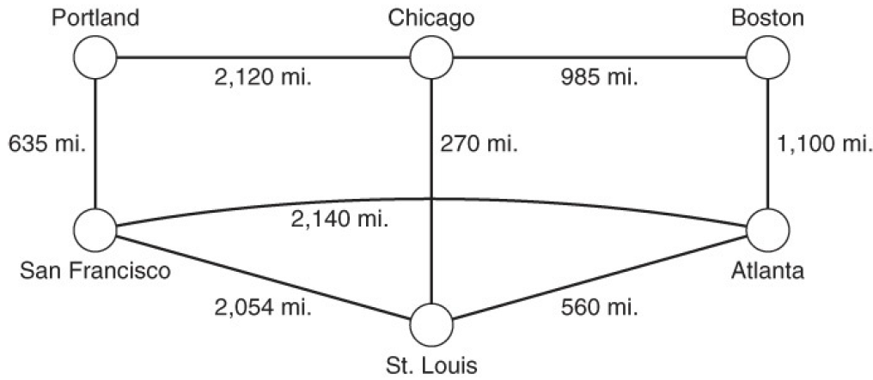
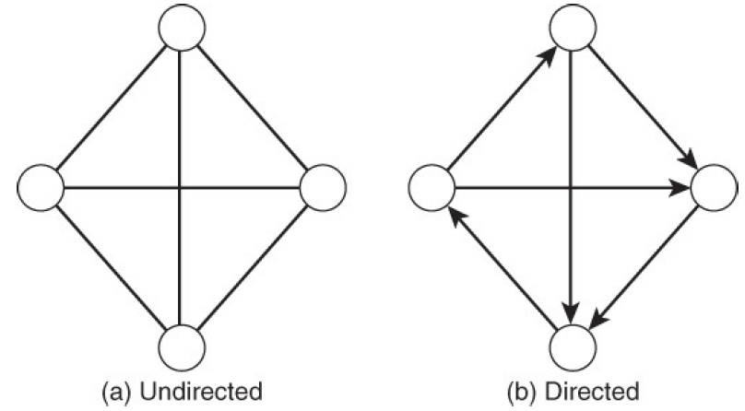
Elements of Graphs
Weighted Edge
Weighted edges have a numeric property associated with them.
Directed and Undirected
Directed and undirected edges further refine properties of relationships
between vertices by capturing directionality.

Slide 10
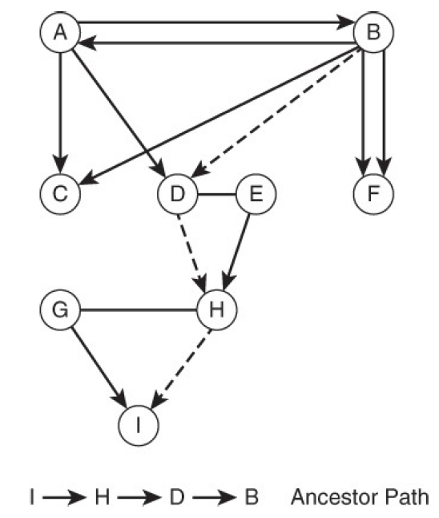
Elements of Graphs
Path
A path through a graph is a set of nodes along with the edges between those nodes Directed and Undirected

Slide 11
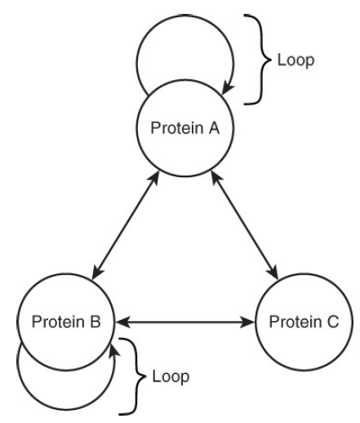
Elements of Graphs
Loop
A loop is an edge that connects a vertex to itself

Slide 12
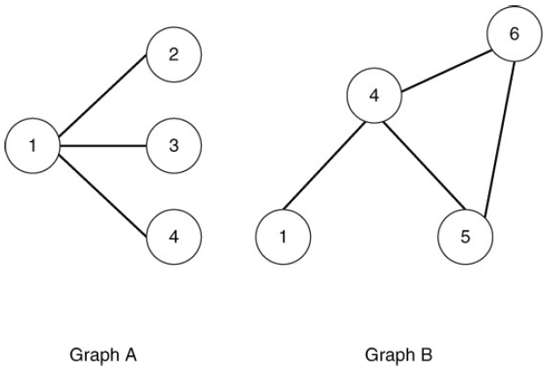
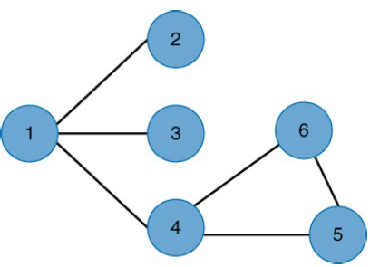
Operations on Graphs
Union of Graphs
The union of graphs is the combined set of vertices and edges in a graph.

Slide 13

Operations on Graphs
Intersection of Graphs
The intersection of a graph is the set of vertices and edges that are common to both graphs

Slide 14
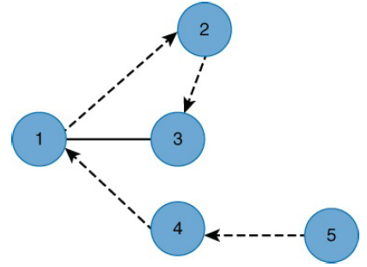
Operations on Graphs
Graph Traversal
Graph traversal is the process of visiting all nodes in a graph in a particular way

Slide 15
Graph Databases Unique Feature
A lot of databases have similar characteristics, but graph databases have a few things that make them unique.
Graph storage
Some graph databases use native graph storage that is specifically designed to store and manage graphs – from bare metal on up. Other graph technologies use relational, columnar or object-oriented databases as their storage layer.
Non-native storage is often slower than a native approach because all of the graph connections have to be translated into a different data model.

Slide 16
Graph Databases Unique Feature
Graph processing
Native graph processing (a.k.a. index-free adjacency) is the most efficient means of processing data in a graph because connected nodes physically point to each other in the database.
Non-native graph processing engines use other means to process Create, Read, Update or Delete (CRUD) operations that aren’t optimized for handling connected data.

Slide 17
Leading companies using Graph Data store
Walmart (recommendation engine)
eBay (artificial intelligence)
Pitney Bowes (master data)
NASA (knowledge graph)
Other Fortune 500 financial services customers (fraud detection)

Slide 18
Leading Graph Data stores
Neo4j
GraphDB Lite
OrientDB
HypherGraphDB
MapGraph
Titan
BrightStarDB
Neptune

Slide 19
Summary
This session will give the knowledge about
Graph DB Introduction

